Slide 1

BCAC 0019 Web Technology -1
Dr. KANTA PRASAD SHARMA ( K P SHARMA)
Assistant Professor,
Computer Engineering & Applications,
GLA University, Mathura

Slide 2
Syllabus

Slide 3
Books
Text Books:
Thomas Powell, ”HTML & CSS: The Complete Reference , Fifth Edition, 2010, McGraw Hill Education India
Reference Books:
Deborah S. Ray, Eric J. Ray , “Mastering HTML 4”, 2nd Ed, Willy India
Steven M. Schafer, “HTML, XHTML, and CSS Bible”, 5ed Wiley India
John Duckett, “Beginning HTML, XHTML, CSS, and JavaScript” , Wiley India
Wendy Willard, HTML: A Beginner's Guide, Fifth Edition 2013, TMH

Slide 4
WHY Need Web TECHNOLOGY ??
Technology
Web
Connect with world
Brief with Internet
Brief with Browser
Website Design
Website Types
Domain and Hosting

Slide 5
What is TERMINOLOGY
Server
Server → provide service
Service → Communication Service
Web Browser
Used to Browse the → ???
Why need to browse → ???
Web Page
Collection of data elements for display the output
Static & Dynamic → [ .html / .asp / .com etc ]
Communicate with Web Server → TALK
PROTOCOL

Slide 6
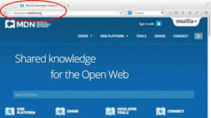
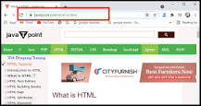
WEB PAGE
A document which can be displayed in a web browser.
web page is a document available on world wide web.
Web Pages are stored on web server and can be viewed using a web browser.
A web page can cotain huge information including text, graphics, audio, video and hyper links.
These hyper links are the link to other web pages.

Slide 7
Dynamic or CMS
static
Web
E-Commerce
A web page or webpage is a document,
commonly written in HTML,
That is viewed in an Internet browser.
A web page can be accessed
by entering a URL address into a browser's address bar.

Slide 8
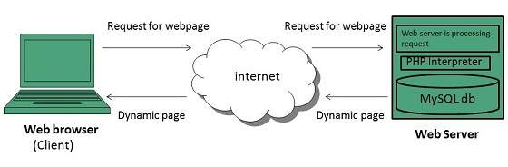
How does a Web Page Work

Slide 9
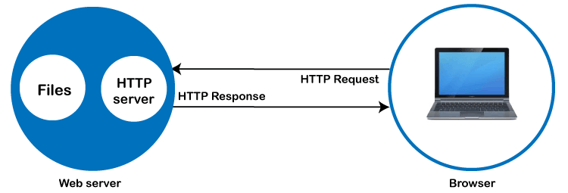
How does a Web Page Work

Slide 10
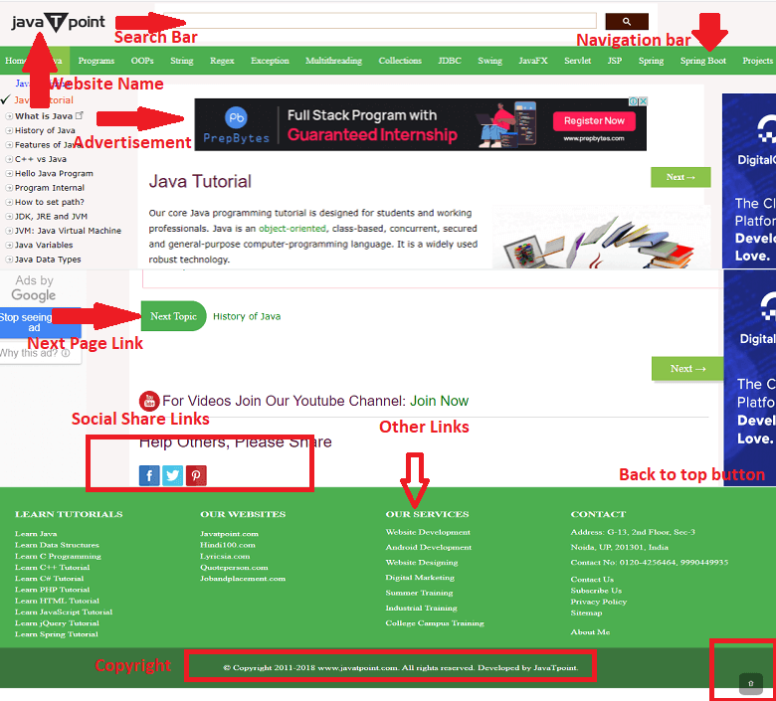
WEB SITE EXAMPLE

Slide 11
WEB SITE TYPES
Ecommerce websites.
Personal
Portfolio
Small business websites
Blog websites.

Slide 12
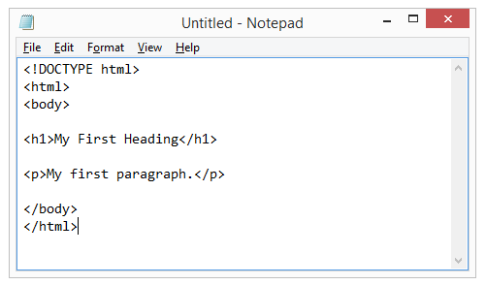
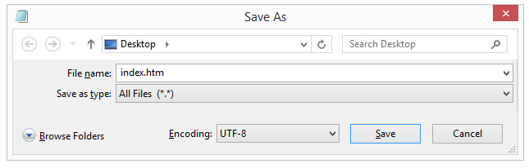
How to Start
Step 1: Open Notepad (PC)
Start > Programs > Accessories > Notepad
Start Screen (the window symbol at the bottom left on your screen). Type Notepad.
Step 1: Open TextEdit (Mac)
Open Finder > Applications > TextEdit
Step 1. Open Notepad / Text Edit/ Edit plus Etc.
Step 2. Write Some HTML
Step 3. Save the HTML Page
Step 4. View the HTML Page in Your Browser

Slide 13
FIRST PAGE DESIGN
<!DOCTYPE html>
<html>
<head> my page </head>
<title>first page</title>
<body>
<H1> My Lovely Students are here </H1>
</body>
</html>

Slide 14
Webpage -→ STATIC OR DYNAMIC
A webpage is defined as a single document or a solitary page of any website.
Every webpage is attached to a unique URL address used to render or access that particular page.
These URLs and webpages can be private or public, depending on how the developers have configured them.
Any web browser can be used to navigate URLs,
Viewing a website does not usually need any navigation if we have its URL address.
Most URLs are connected to a website that helps developers create a proper sitemap and structured user interface.
This also helps with search engine optimization (SEO).

Slide 15
Characteristics
The following are the characteristics of the webpage:
Being a part of a website, the web page contains several topics linked to the website.
Different webpages can use the same name (title name),
but they should reside in different documents having different URLs.
Webpages take less time to be developed as compared to the website.
The webpage is relatively easy to develop.

Slide 16
website
is a collection of several webpages linked together using hyperlinks.
All the webpages are linked under a single domain to uniquely identify the website.
Websites are the main source of connecting hyperlinks to different sections,
These sections may further include other relevant webpages.
Webpage, people can easily navigate any website using a web browser and entering the domain address.
Websites also follow the same programming languages for the development,
which are required for webpage development.
However, website development is complex and takes more time.

Slide 17
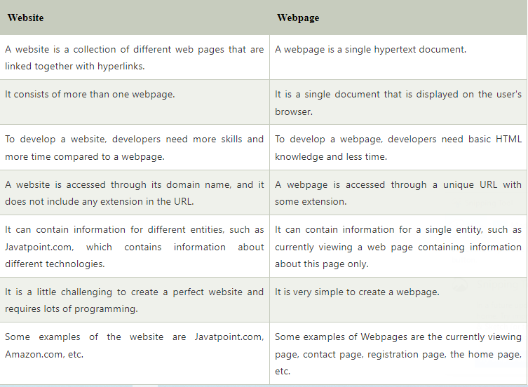

Slide 18
Web browser
Today web browsers are easily accessible and can be used on devices like computer, laptops, mobile phones, etc.
But this evolution of making browsers available for easy use took many years.
Web Browser is a software application.
for accessing the information on the World Wide Web.
It is the function of the web browser to retrieve the information.
Requested by the user from any website.

Slide 19
History of Browser
1990 , “WorldWideWeb” → Tim Berners Lee [Nexus]
1993, the “Mosaic”→ Netscape [ world first popular web browser]
994 → “Netscape Navigator” → Yahoo
1995, “Internet Explorer” → Microsoft.
2002, “Mozilla Firefox” → Internet Explorer
2003 and named it “Safari”→ Apple [Apple devices ]
2008, “Chrome”→ Google
Internet Explorer
Google Chrome
Safari
Mozilla Firefox
Microsoft Edge

Slide 20
ASSIGNMENT
1. Find out 10 IT company name with logo and head office with website.
2. Write difference between web client/ web server & web site and web server.

Slide 21


Slide 22
HEADING TAGS
HTML headings are titles or subtitles that you want to display on a webpage.
<h1>Heading 1</h1>
<h2>Heading 2</h2>
<h3>Heading 3</h3>
<h4>Heading 4</h4>
<h5>Heading 5</h5>
<h6>Heading 6</h6>
<h1 style="font-size:60px;">Heading 1</h1>
<h1 style="background-color:powderblue;"> Dr K P SHARMA</h1>
entire row will be colored as light blue
<p style="background-color:tomato;"> DR K P SHARMA.</p>
entire row will be colored as tomato

Slide 23
Paragraph TAG
A paragraph always starts on a new line, and browsers automatically add some white space (a margin) before and after a paragraph.
You cannot be sure how HTML will be displayed.
Large or small screens, and resized windows will create different results.
With HTML, you cannot change the display by adding extra spaces or extra lines in your HTML code.
<p> This is the best place for study and converting your dream into reality. </p>

Slide 24
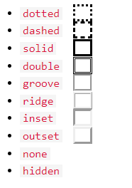
Table tag
<table> <tr> <th>Sr.No</th> <th>Name</th> <th>phone no</th> </tr> <tr> <td>1</td> <Dr. Kanta Prasad </td> <td>9760207629</td> </tr> <tr> <td>2</td> <td>Sonali Vyas</td> <td>985852456</td> </tr>
</table>

Slide 25
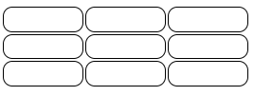
Stylist Table
<style>
table, th, td
{
border: 1px solid black;
border-radius: 10px;
}
</style>
th, td { border-color: #96D4D4; }

Slide 26
IMAGE TAG
<!DOCTYPE html>
<html>
<body>
<h1>The img element</h1>
<img src=“kpsharma.jpg" alt=“hello" width="500" height="600">
</body>
</html>

Slide 27
FORM TAG
The <form> element can contain one or more of the following form elements:
<input>
<Textarea>
<button>
<Select>
<Option>
<Optgroup>
<Fieldset>
<Label>
<output>

Slide 28
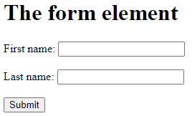
FORM TAG
<!DOCTYPE html>
<html>
<body>
<h1>The form element</h1>
<form action="/action_page.php">
<label for="fname">First name:</label>
<input type="text" id="fname" name="fname"><br><br>
<label for="lname">Last name:</label>
<input type="text" id="lname" name="lname"><br><br>
<input type="submit" value="Submit">
</form>
</body> </html>

Slide 29

<!DOCTYPE html>
<html>
<body>
<h1>The option element</h1>
<label for="cars">Choose a car:</label>
<select id="cars">
<option value="volvo">Volvo</option>
<option value="saab">Saab</option>
<option value="opel">Opel</option>
<option value="audi">Audi</option>
</select>
</body> </html>

Slide 30
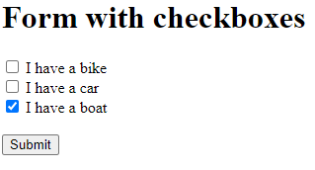
CHECKBOXES
<body>
<h1>Form with checkboxes</h1>
<form action="/action_page.php" method="get">
<input type="checkbox" name="vehicle1" value="Bike">
<label for="vehicle1"> I have a bike</label><br>
<input type="checkbox" name="vehicle2" value="Car">
<label for="vehicle2"> I have a car</label><br>
<input type="checkbox" name="vehicle3" value="Boat" checked>
<label for="vehicle3"> I have a boat</label><br><br>
<input type="submit" value="Submit">
</form>
</body>

Slide 31
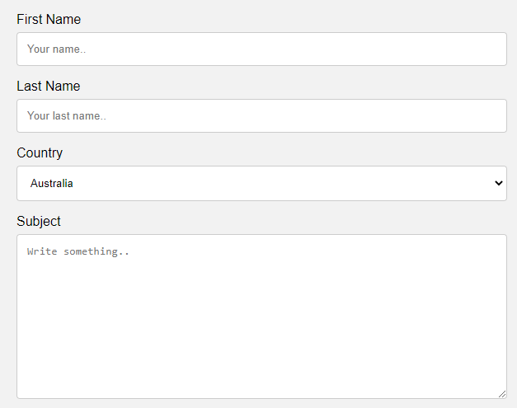
TEXT AREA
<textarea id="subject" name="subject" placeholder="Write something.." style="height:200px">
</textarea>

Slide 32
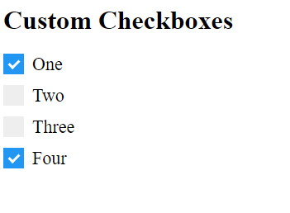
Checkbox
<h1>Custom Checkboxes</h1>
<label class="container">One <input type="checkbox" checked="checked">
<span class="checkmark"></span>
</label>
<label class="container">Two
<input type="checkbox">
<span class="checkmark"></span>
</label>
<label class="container">Three
<input type="checkbox">
<span class="checkmark"></span>
</label>
<label class="container">Four
<input type="checkbox"> <span class="checkmark"></span>
</label>
</body>
</html>

Slide 33
SUB /SUP TAG
<!DOCTYPE html>
<html>
<body>
<h1>The sub and sup elements</h1>
<p>H <sub>2</sub> O</p>
<X<sup>3</sup>Y </p>
</body>
</html>

Slide 34
Cellpadding and Cellspacing Attributes
There are two attributes called
cellpadding
cellspacing
which you will use to adjust the white space in your table cells.
The cellspacing attribute defines space between table cells,
while cellpadding represents the distance between cell borders and the content within a cell

Slide 35
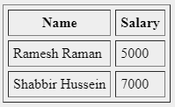
Example
<body>
<table border = "1" cellpadding = "5" cellspacing = "5">
<tr> <th>Name</th>
<th>Salary</th> </tr>
<tr> <td>Ramesh Raman</td>
<td>5000 </td>
</tr>
<tr> <td>Shabbir Hussein</td>
<td>7000</td>
</tr>
</table>
</body>

Slide 36
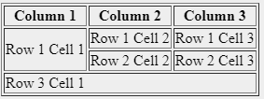
Colspan and Rowspan Attributes
You will use colspan attribute
if you want to merge two or more columns into a single column.
Similar way you will use rowspan
if you want to merge two or more rows

Slide 37
EXAMPLE.
<Body>
<table border = "1">
<tr> <th> Column 1</th> <th>Column 2</th> <th>Column 3</th> </tr>
<tr> <td rowspan = "2"> Row 1 Cell 1</td> <td>Row 1 Cell 2</td> <td>Row 1 Cell 3</td> </tr>
<tr> <td>Row 2 Cell 2</td> <td>Row 2 Cell 3</td> </tr>
<tr> <td colspan = "3">Row 3 Cell 1</td> </tr>
</table>
</Body>

Slide 38
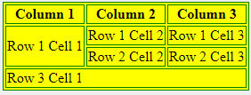
Tables Backgrounds
bgcolor attribute −
You can set background color for whole table or just for one cell.
background attribute
You can set background image for whole table or just for one cell.

Slide 39
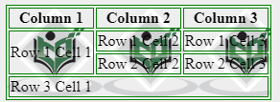
Example
<body>
<table border = "1" bordercolor = "green" background = "/images/test.png">
<tr> <th>Column 1</th> <th>Column 2</th> <th>Column 3</th> </tr>
<tr> <td rowspan = "2">Row 1 Cell 1</td> <td>Row 1 Cell 2</td> <td>Row 1 Cell 3</td> </tr>
<tr> <td>Row 2 Cell 2</td> <td>Row 2 Cell 3</td> </tr>
<tr> <td colspan = "3">Row 3 Cell 1</td> </tr>
</table>
</body>

Slide 40
Figure tag
The <figure> tag specifies self-contained content, like illustrations, diagrams, photos, code listings, etc.
While the content of the <figure> element is related to the main flow, its position is independent of the main flow, and if removed it should not affect the flow of the document.

Slide 41
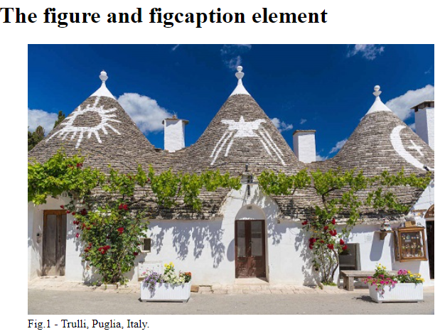
Fram tag - caption
!DOCTYPE html>
<html>
<body>
<h1>The figure and figcaption element</h1>
<figure>
<img src="pic_trulli.jpg" alt="Trulli" style="width:100%">
<figcaption>Fig.1 - Trulli, Puglia, Italy.</figcaption>
</figure>
</body>
</html>

Slide 42
Footer Tag
Definition and Usage
The <footer> tag defines a footer for a document or section.
authorship information
copyright information
contact information
sitemap
back to top links
related documents

Slide 43
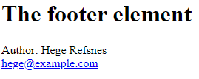
Framesets
<!DOCTYPE html>
<html>
<body>
<h1>The footer element</h1>
<footer>
<p>Author: Hege Refsnes<br>
<a href="mailto:hege@example.com">hege@example.com</a>
</p>
</footer>
</body>
</html>

Slide 44
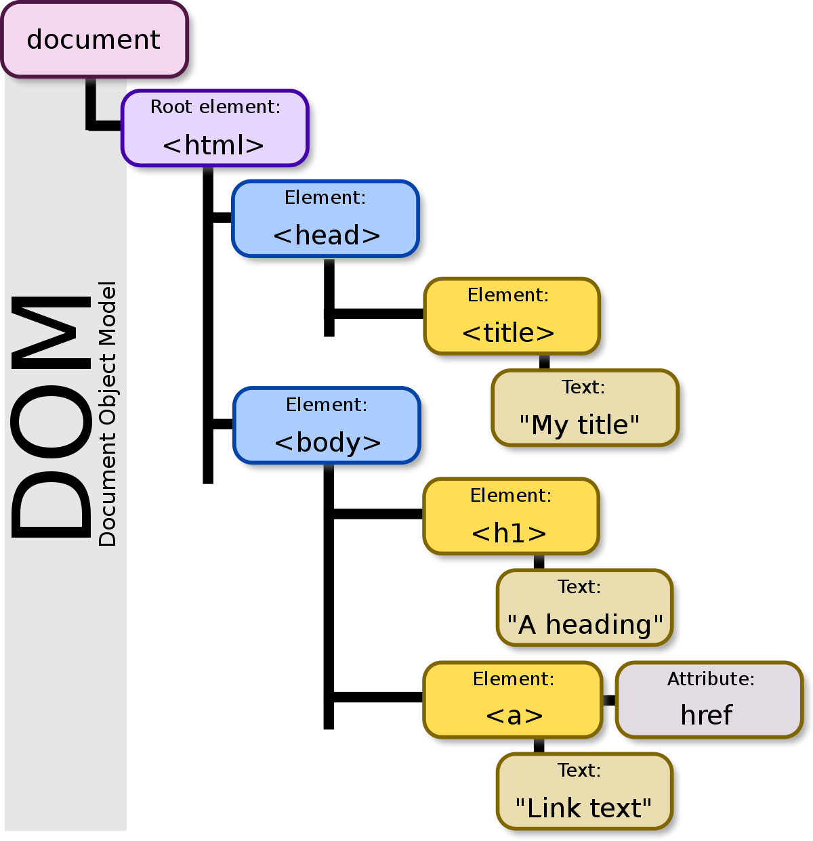
DOM- Document object model
Programming API for HTML and XML documents.
It defines → [logical structure ] →[documents]
the[ way ]→[accessed and manipulated]
→???

Slide 45
DHTML: Dynamic Hypertext Markup
DHTML stands for Dynamic Hypertext Markup language i.e., Dynamic HTML.
Dynamic HTML is not a markup or programming language
It is a term that combines the features of various web development technologies for creating the web pages dynamic and interactive.
DHTML application was introduced by Microsoft with the release of the 4th version of IE (Internet Explorer) in 1997.

Slide 46
USES OF DHTML
used for designing the animated and interactive web pages that are developed in real-time.
Helps users by animating the text and images in their documents.
It allows the authors for adding the effects on their pages.
It also allows the page authors for including the drop-down menus or rollover buttons.
This term is also used to create various browser-based action games.
Used to add the ticker on various websites, which needs to refresh their content automatically.

Slide 47
Features
Create the web page dynamically.
Dynamic Style is a feature, that allows the users to alter the font, size, color, and content of a web page.
Facility for using the events, methods, and properties. And, also provides the feature of code reusability.
Feature in browsers for data binding.
Users can easily create dynamic fonts for their web sites or web pages.
Users can easily change the tags and their properties.
The web page functionality is enhanced because the DHTML uses low-bandwidth effect.

Slide 48
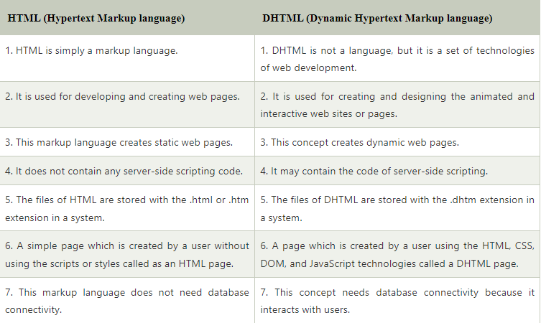
JavaScript
CSS
& DOM
HTML

